Slide 1
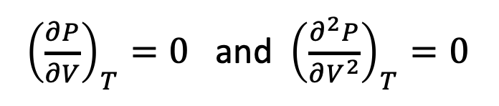
What we did this week
We got acquainted with critical points and corresponding states (as well as computer-assisted calculus in AnalyticalTcrit).

Slide 2
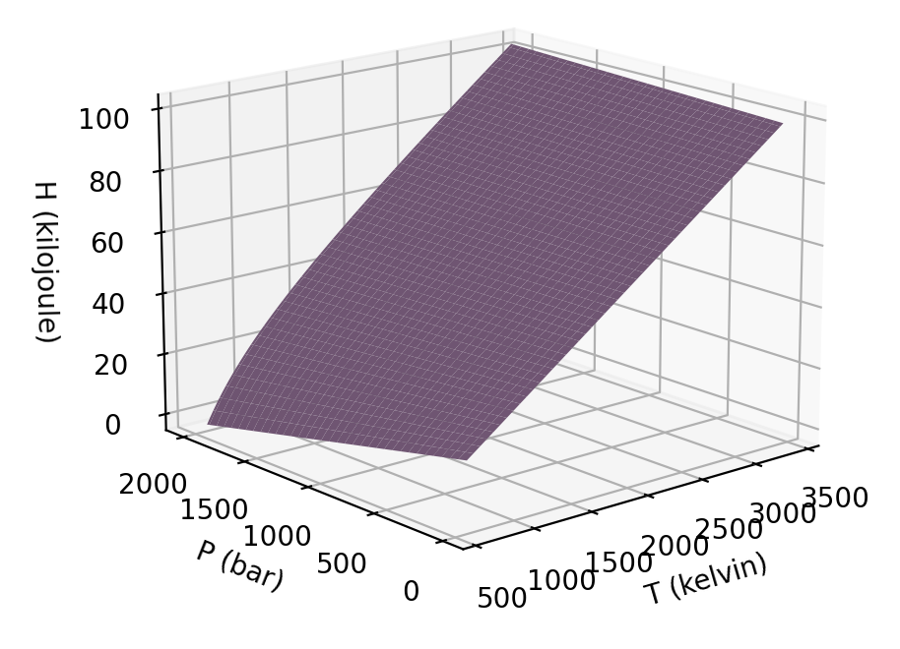
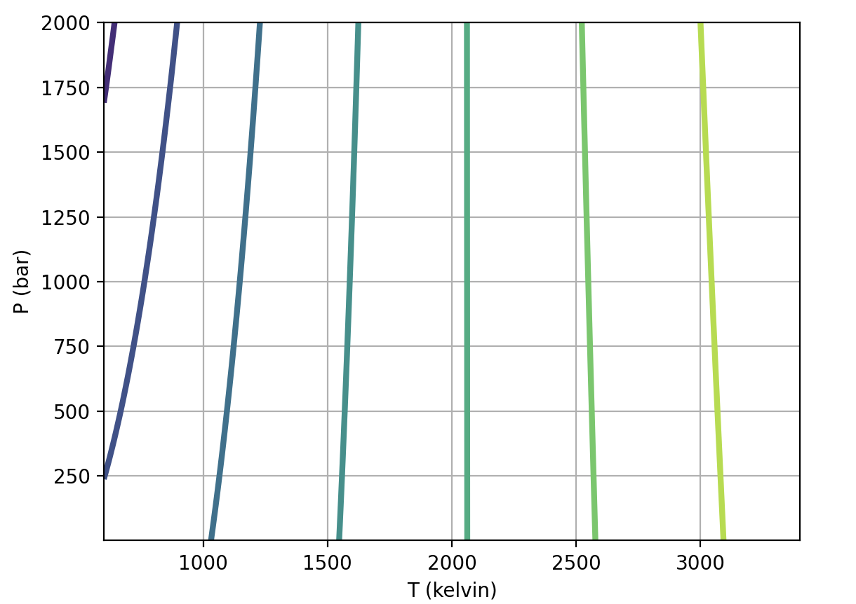
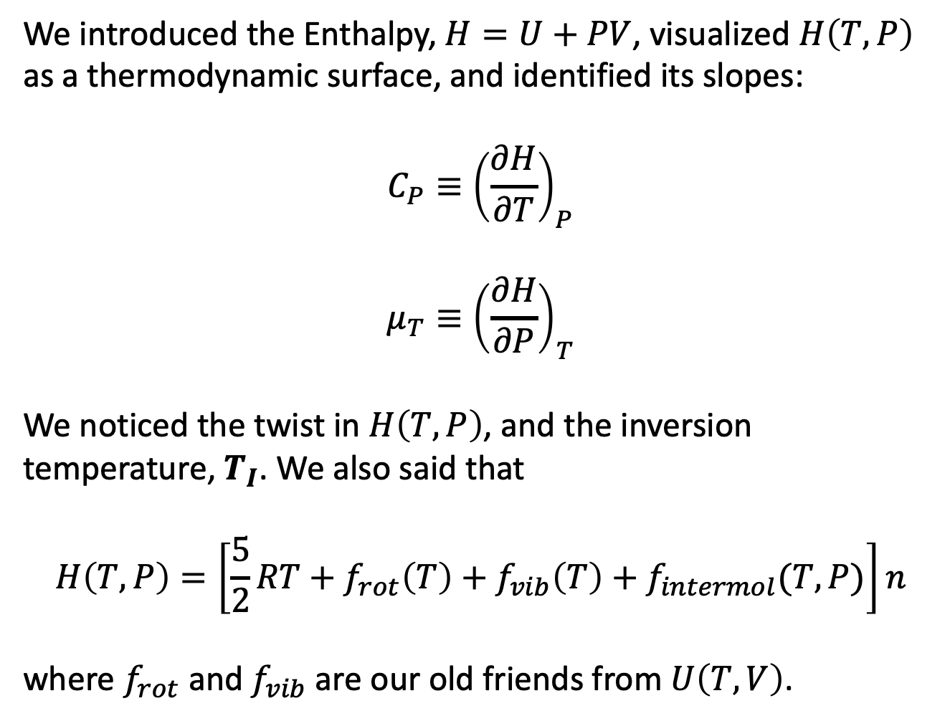
What we did this week
We introduced the Enthalpy, $H=U+PV$, visualized $H\left(T,P\right)$ as a thermodynamic surface, and identified its slopes:
$$C_{P}≡{\left(\frac{∂H}{∂T}\right)}_{P}$$
$$μ_{T}≡{\left(\frac{∂H}{∂P}\right)}_{T}$$
We noticed the twist in $H\left(T,P\right)$, and the inversion temperature, $T_{I}$. We also said that
$$H\left(T,P\right)=\left[\frac{5}{2}RT+f_{rot}\left(T\right)+f_{vib}\left(T\right)+f_{intermol}(T,P)\right]n$$
where $f_{rot}$ and $f_{vib}$are our old friends from $U\left(T,V\right)$.

Slide 3
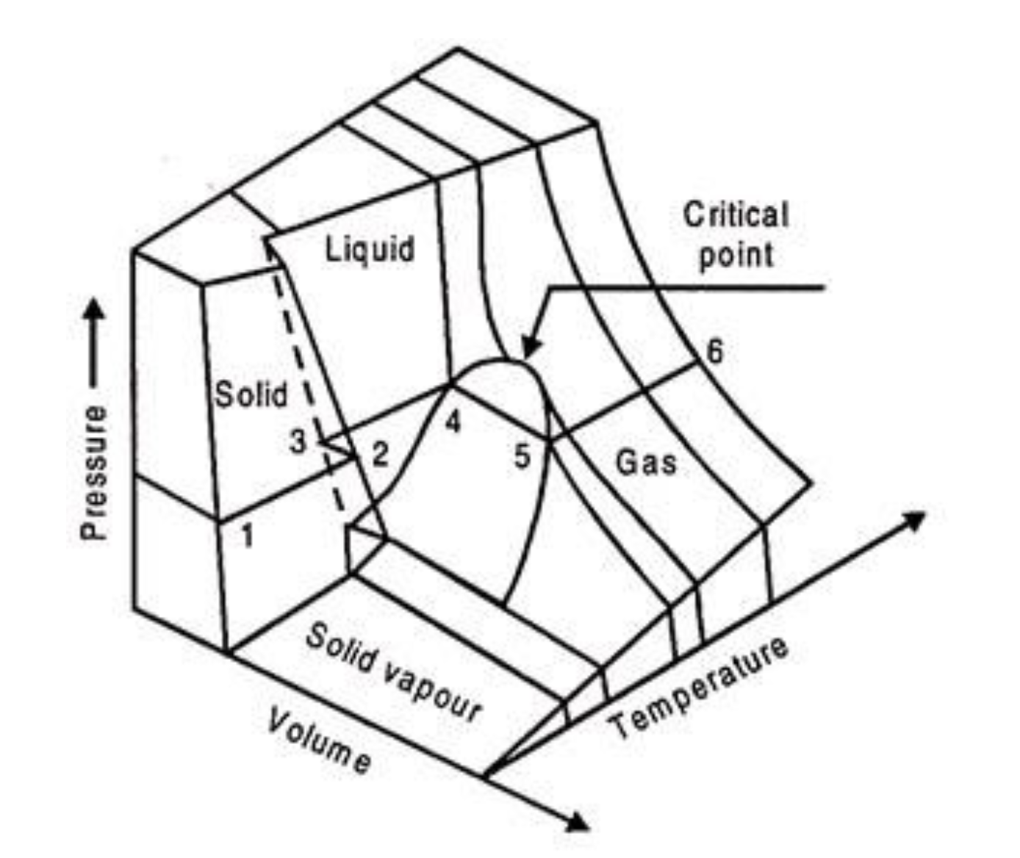
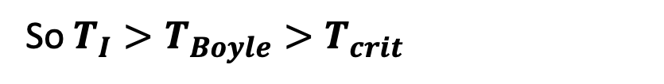


We talked about $\frac{a}{Rb}$ as a unifying idea
$$T_{I}≈2\frac{a}{Rb}$$
$T_{Boyle}≈\frac{a}{Rb}$
$T_{crit}≈\frac{1}{3}\frac{a}{Rb}$
So $T_{I}>T_{Boyle}>T_{crit}$
https://www.engineeringenotes.com/thermal-engineering/real-gases/real-gases-properties-van-der-waals-equation-and-equation-of-state-thermal-engineering/49112

Slide 4
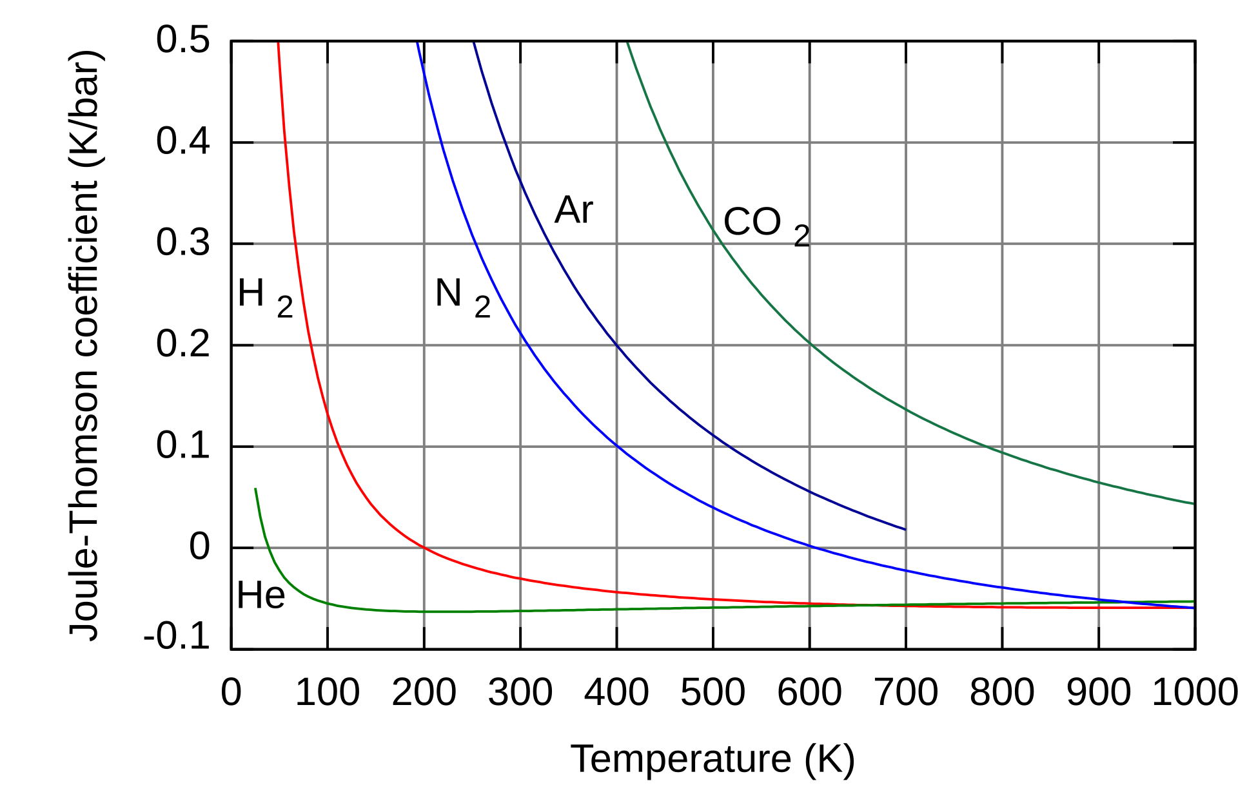
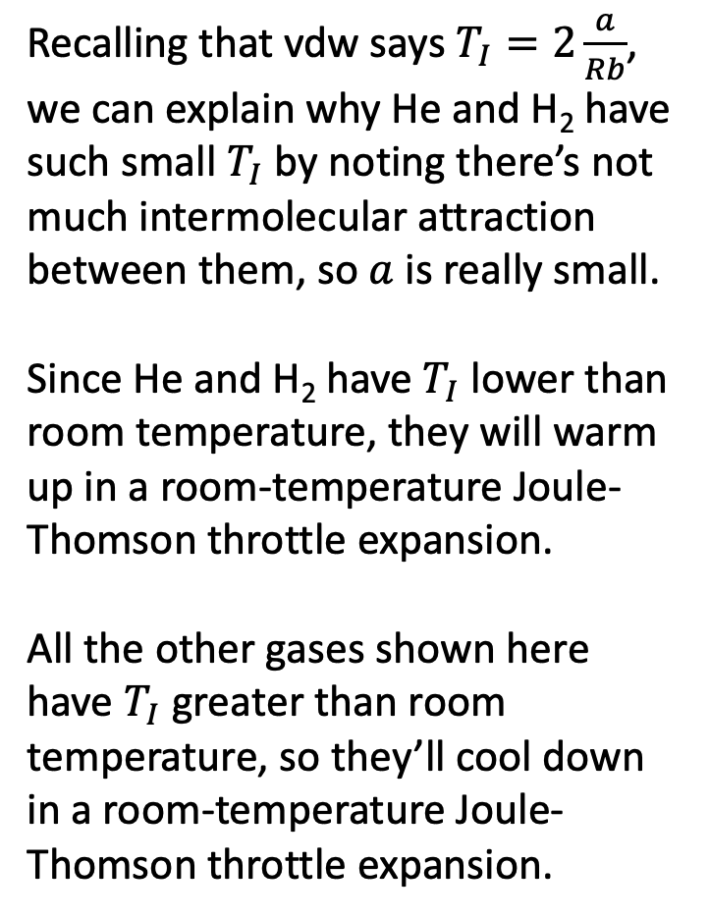
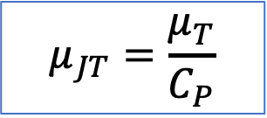
Most gases have really high inversion temperatures (where these curves cross zero)
Recalling that vdw says $T_{I}=2\frac{a}{Rb}$, we can explain why He and H₂ have such small $T_{I}$ by noting there’s not much intermolecular attraction between them, so $a$ is really small.
Since He and H₂ have $T_{I}$ lower than room temperature, they will warm up in a room-temperature Joule-Thomson throttle expansion.
All the other gases shown here have $T_{I}$ greater than room temperature, so they’ll cool down in a room-temperature Joule-Thomson throttle expansion.
$$μ_{JT}=\frac{μ_{T}}{C_{P}}$$
https://en.wikipedia.org/wiki/Joule%E2%80%93Thomson_effect

Slide 5
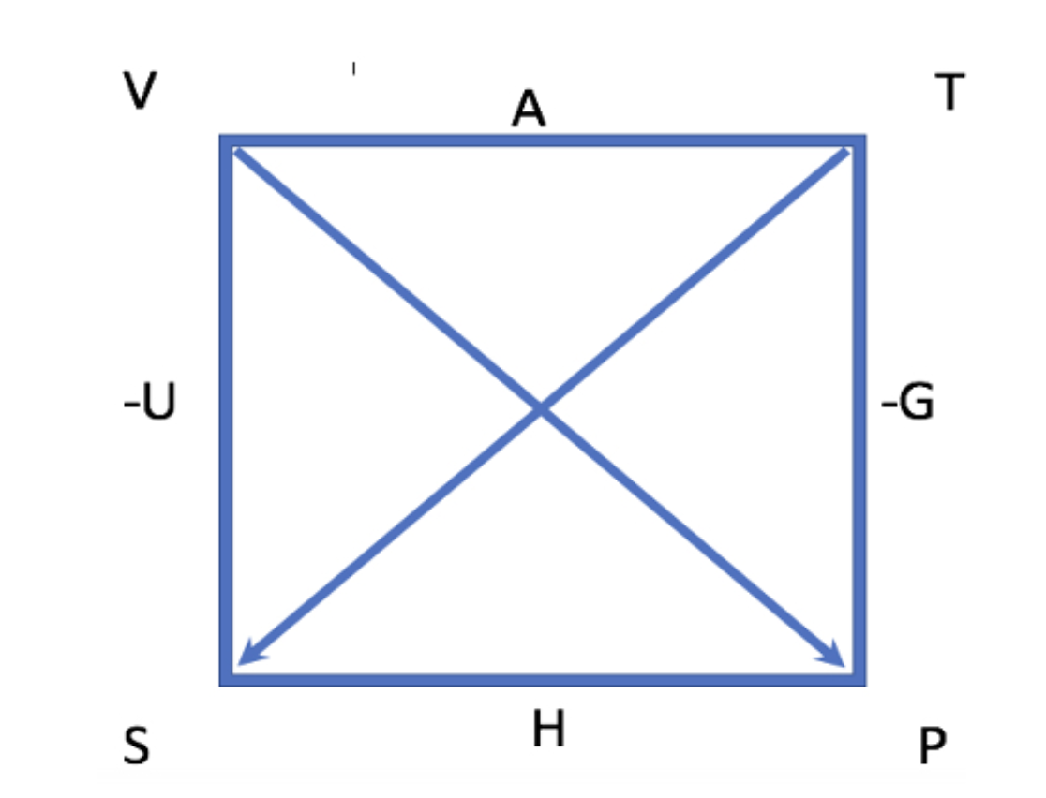
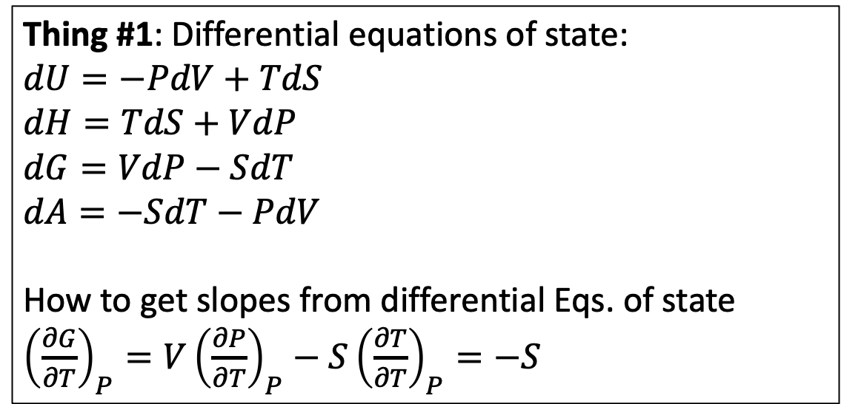
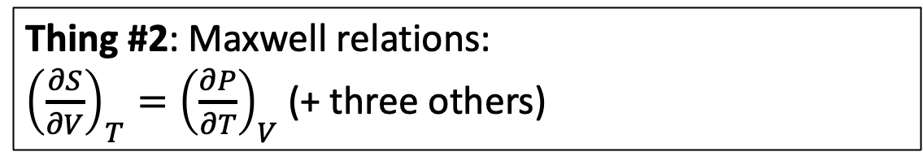
What we did this week
We introduced the Box and found new things we could do with it
Thing #1: Differential equations of state:
$$dU=−PdV+TdS$$
$$dH=TdS+VdP$$
$$dG=VdP−SdT$$
$$dA=−SdT−PdV$$
How to get slopes from differential Eqs. of state
${\left(\frac{∂G}{∂T}\right)}_{P}=V{\left(\frac{∂P}{∂T}\right)}_{P}−S{\left(\frac{∂T}{∂T}\right)}_{P}=−S$
Thing #2: Maxwell relations:
${\left(\frac{∂S}{∂V}\right)}_{T}={\left(\frac{∂P}{∂T}\right)}_{V}$ (+ three others)

Slide 6
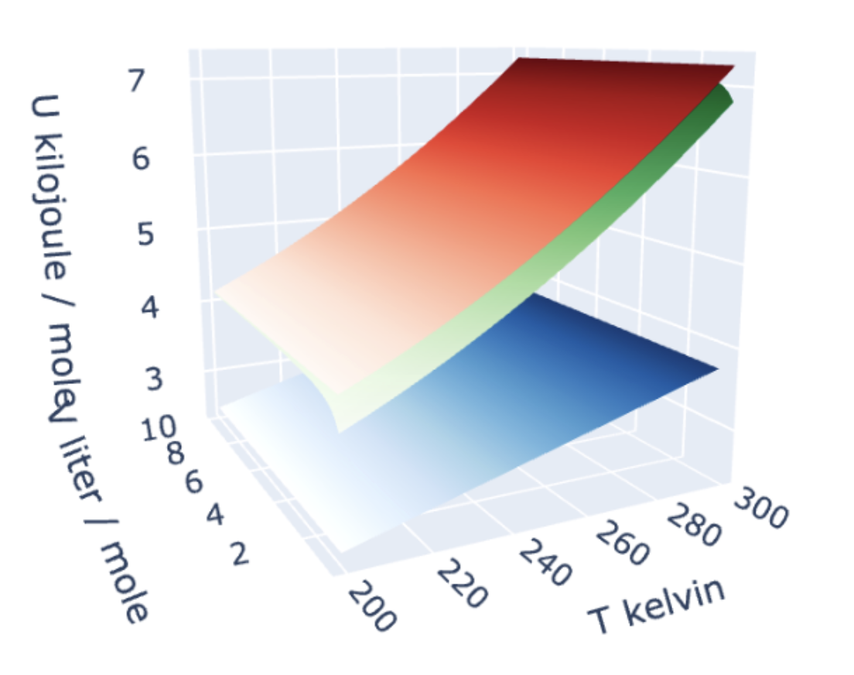
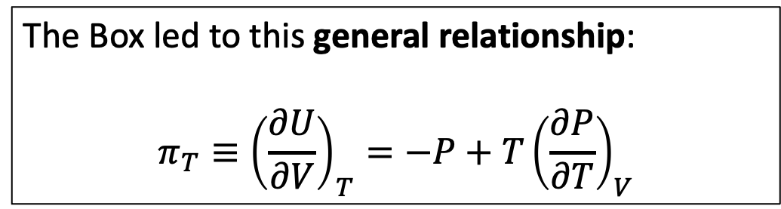
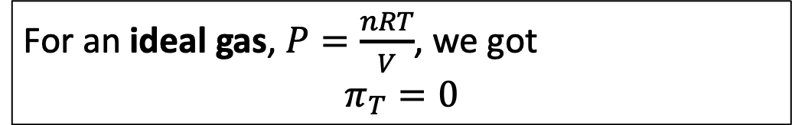

What we did this week
The Box led to this general relationship:
$$π_{T}≡{\left(\frac{∂U}{∂V}\right)}_{T}={−P+T\left(\frac{∂P}{∂T}\right)}_{V}$$
For an ideal gas, $P=\frac{nRT}{V}$, we got
$$π_{T}=0$$
For a vdw gas, $P=\frac{nRT}{V−nb}−\frac{an^{2}}{V^{2}}$, we got
$$π_{T}=\frac{an^{2}}{V^{2}}$$

Slide 7

Moving on a bit: Berthelot also had a gas (model)
The Box led to this general relationship:
$$π_{T}≡{\left(\frac{∂U}{∂V}\right)}_{T}={−P+T\left(\frac{∂P}{∂T}\right)}_{V}$$
For an ideal gas, $P=\frac{nRT}{V}$, we got
$$π_{T}=0$$
For a vdw gas, $P=\frac{nRT}{V−nb}−\frac{an^{2}}{V^{2}}$, we got
$$π_{T}=\frac{an^{2}}{V^{2}}$$
For a Berthelot gas, $P=\frac{nRT}{V−nb}−\frac{an^{2}}{{TV}^{2}}$,
$$π_{T}=\frac{2an^{2}}{{TV}^{2}}$$
We’ll get this today

Slide 8
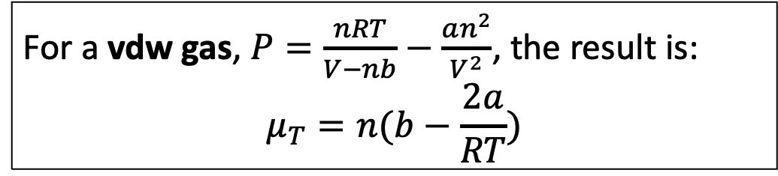
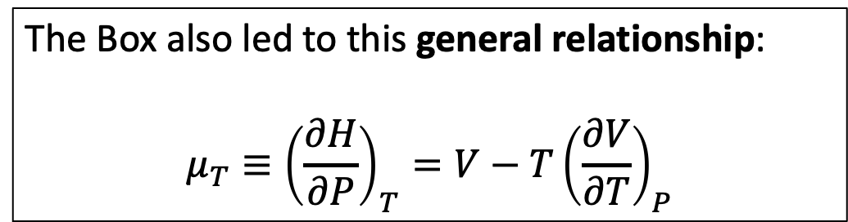

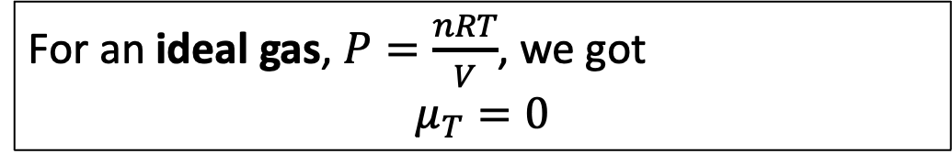
Moving on a bit: Berthelot also had a gas (model)
The Box also led to this general relationship:
$$μ_{T}≡{\left(\frac{∂H}{∂P}\right)}_{T}={V−T\left(\frac{∂V}{∂T}\right)}_{P}$$
For an ideal gas, $P=\frac{nRT}{V}$, we got
$$μ_{T}=0$$
For a vdw gas, $P=\frac{nRT}{V−nb}−\frac{an^{2}}{V^{2}}$, the result is:
$$μ_{T}=n(b−\frac{2a}{RT})$$
Didn’t derive, but we can argue that these are plausible formulas if they reproduce the twist … do they? (That’s a blackboard activity for today.)
For a Berthelot gas, $P=\frac{nRT}{V−nb}−\frac{an^{2}}{V^{2}}$,
$$μ_{T}=n(b−\frac{3a}{RT^{2}})$$

Slide 9
Blackboard: Show how vdw’s $μ_{T}$ and Berthelot’s $μ_{T}$ each explain the twist
At high temperature …
At low temperature …

Slide 10
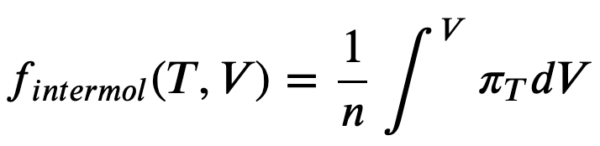
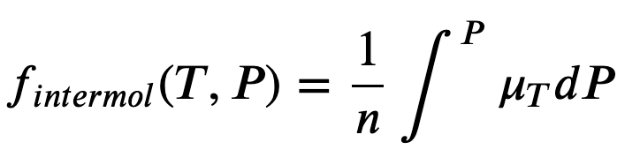
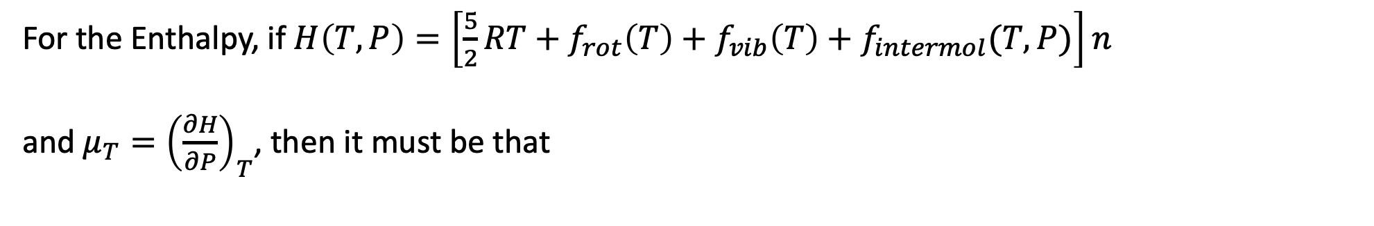
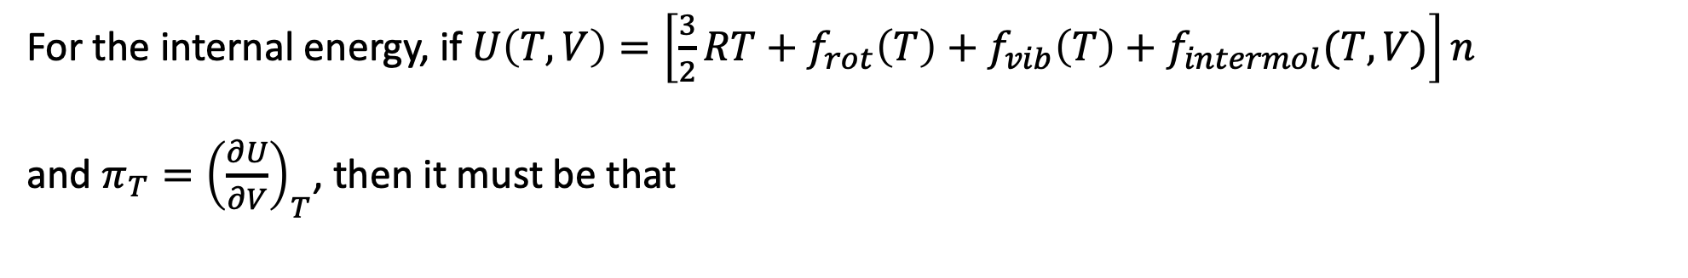
After the blackboard: skipping AnalyticalmuT, instead going on to AnalyticalU&H
For the internal energy, if $U\left(T,V\right)=\left[\frac{3}{2}RT+f_{rot}\left(T\right)+f_{vib}\left(T\right)+f_{intermol}(T,V)\right]n$
and $π_{T}={\left(\frac{∂U}{∂V}\right)}_{T}$, then it must be that
For the Enthalpy, if $H\left(T,P\right)=\left[\frac{5}{2}RT+f_{rot}\left(T\right)+f_{vib}\left(T\right)+f_{intermol}(T,P)\right]n$
and $μ_{T}={\left(\frac{∂H}{∂P}\right)}_{T}$, then it must be that

Slide 11
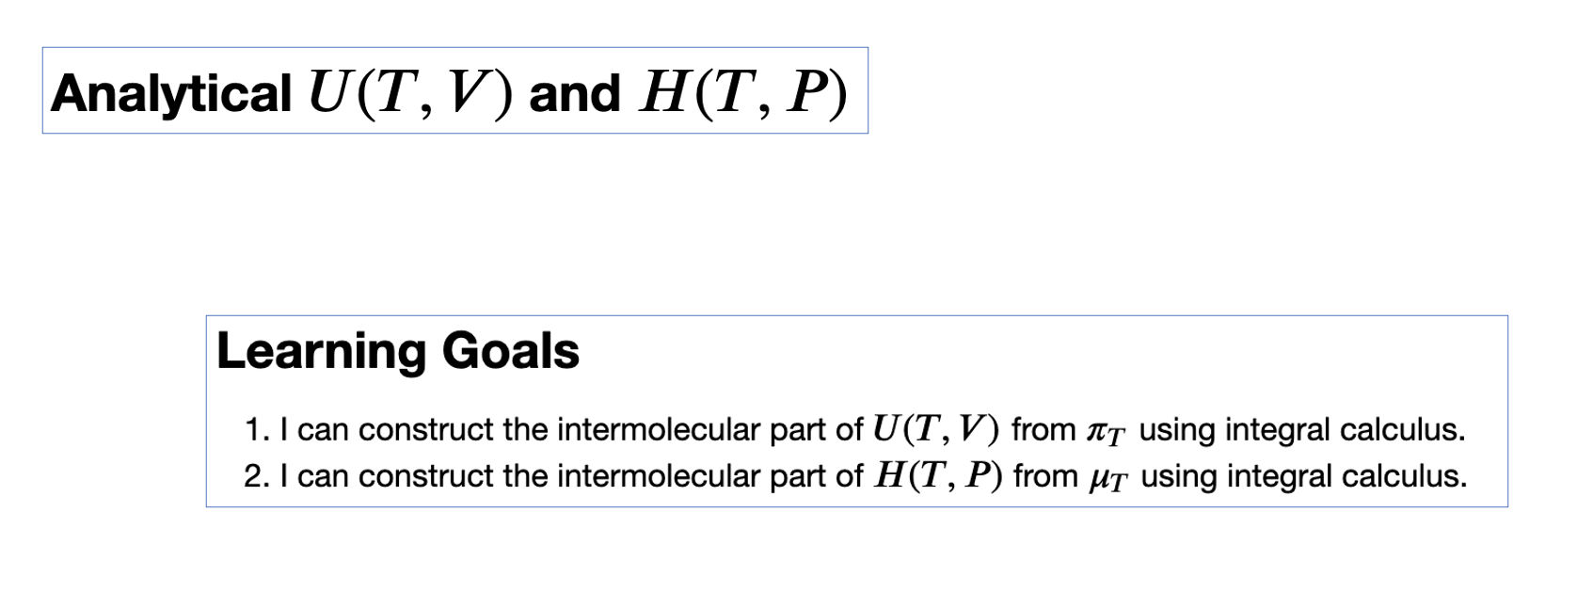
Then we’ll work on the CGI

